Slide 1
Java basics, structure of class, defining variables
Module 2

Slide 2
Content
Java architecture
Hello java
Identifiers
Variables – types
Variables
Scope of variables
Facts about the quiz

Slide 3
Java architecture
JVM – Java virtual machine
Abstract / Virtual machine
Installable to any OS
JVM performs:
Compile classes
convert code instructions into byte codes
Provide runtime env
Execute the byte code

Slide 4
Java architecture
JRE
All required to run a java program
Includes JVM, Java Class Library
JDK
JRE + javac and tools (Javadoc and jdb)
compile and executes java programs

Slide 5
Java architecture
JDK – Java development kit / tool
javac
jar
JRE – java runtime env
java
Other core libraries
Others
JVM – Java Virtual Machine

Slide 6
Hello java Demo
Demo javac + java commands

Slide 7
Hello java
package bg.newhorizons.test;
public class HelloJava {
public static void main() {
System.out.println(“Hello java”);
} }
public on class level | visible to all other classes
public on a method level | visible to all other classes, could be called by anyone other class
static method | belongs to a class, rather than to an instance of a class
void | the method return nothing
System.out.println(“Hello java”); | - executable block of the method

Slide 8
Hello Java
package bg.newhorizons.test;
public class HelloJava {
public static void main() {
System.out.println(“Hello java”);
}
Rules - package declaration is always first! (indicates in which package that class belongs to)
- Class at root level - meaning the class name with the name of .java file is always public
1. Class declaration for HeloJava.java private class HelloJava {} is wrong!
2. public class HelloJava { package bg.newhorizons.test }
is wrong!

Slide 9
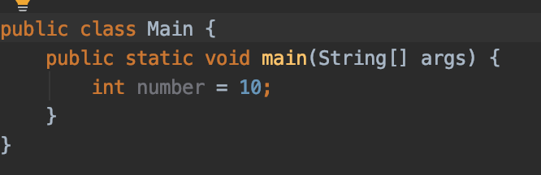
Identifiers
- Words being used in the java programs
- Identify a variable, class names, methods, interfaces
Main – class name
main – method name
number – variable name
Note:
static and public could be vs, but the return type of the method should be always after static and visibility (public in this case)
static public void main(Strinf [] args) is valid
public void static main(String [] args) is NOT valid

Slide 10
Identifiers
An identifier can be made of
Letters / alphabetic characters
Digits
Underscore character (_)
Dollar sigh ($)
Reserved words in java can not be identifiers (public, static, int …)
Can not start with digit!
Correct identifier name | Incorrect identifier name
myVariable | 123number
x1 | c+c
_myvariable | geek@
$myvariable | variable-2
Sum_of_array | sam&Jon
number123

Slide 11




















Variables - types
Data Types in java
Primitive data types
Non-Primitive data types
Boolean types
Numeric types
Character value
Integral value
Integer
Floating points
boolean
character
String
Array
Etc ..
byte
short
int
float
float
double

Slide 12
Variables – types
TYPE | DESCRIPTIO N | SIZE | EXAMPLE VALUE | RANGE OF VALUES
Boolean | True or false | 1 bit | true | True, false
byte | Small number | 8 bits | 15 | -128, 127
char | Unicode character | 16 bits | ‘P’, ‘\\’, ‘\n’ | Character representation of ASCI values 0 to 255 - letter, a digit, a punctuation mark, a tab, a space or something similar.
short | Bigger number | 16 bits | 786 | -32,768, 32, 767
int | Bigger that short number | 32 bits | 897657 | ~-2.147m-+~2.147m
long | Bigger than int number | 64 bits | -2L, +8L
Float | IEEE 754 floating point | 32 bits | 1.23, 1.23e100f | Up to 7 digits
Double | IEEE 754 floating point | 64 bits | 1.32456e300d, 1e1d | Up to 16 digits

Slide 13
Variables
int count = 0;
int – type
count – name of the variable (identifier)
0 – value of the variable
char number = 25; // is also valid!

Slide 14
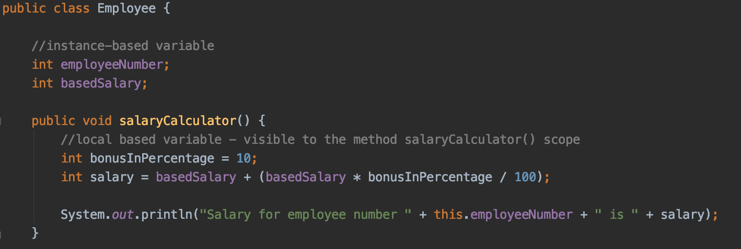
Variables
Local variables
Defined within a block, method or a constructor
The scope is in the block where variable is created
Created when the function is called and destroyed immediately after the function call is returned
Local variables prohibit the use of access modifiers (private, protected, public)
Can be accessed only within the particular block

Slide 15
Variables
Instant variables
Declared in a class, outside a block, a method, or a constructor
They are not static
Initialized when object is crated
Accessed via instance of class
Access modifiers can be used for instance variables
When no modifier is specified, the default modifier is used
Instance Variables have default values, 0 for numbers, false for Boolean, and null for object references

Slide 16

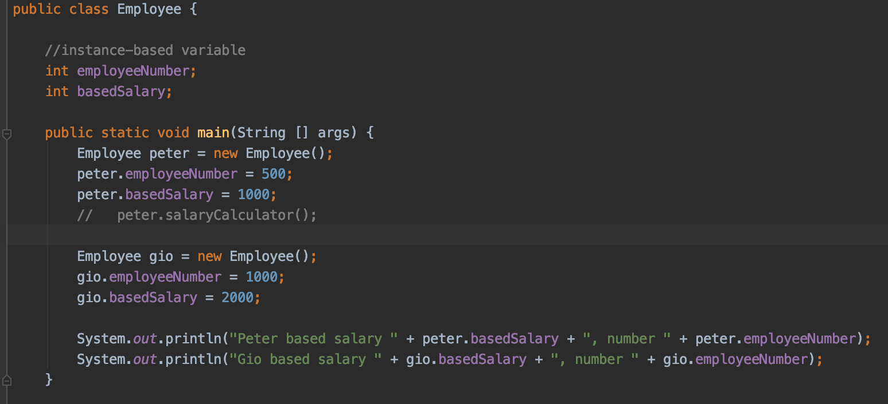
Variables
Instance variables

Slide 17
Variables
Static variables
On class level but with static key word
The major difference between instance and static variables is that they are declared using the static keyword and only a single copy of a static variable per class is allowed
Value per class, not per class instance / object
Access via class
These variables are created at the start of the program and are automatically destroyed when the execution of the program is completed.
The default values of the static variables are the same as the instance variables.
To access static variables, creating an object of that class is not necessary
They are access via: class_name.variable_name

Slide 18
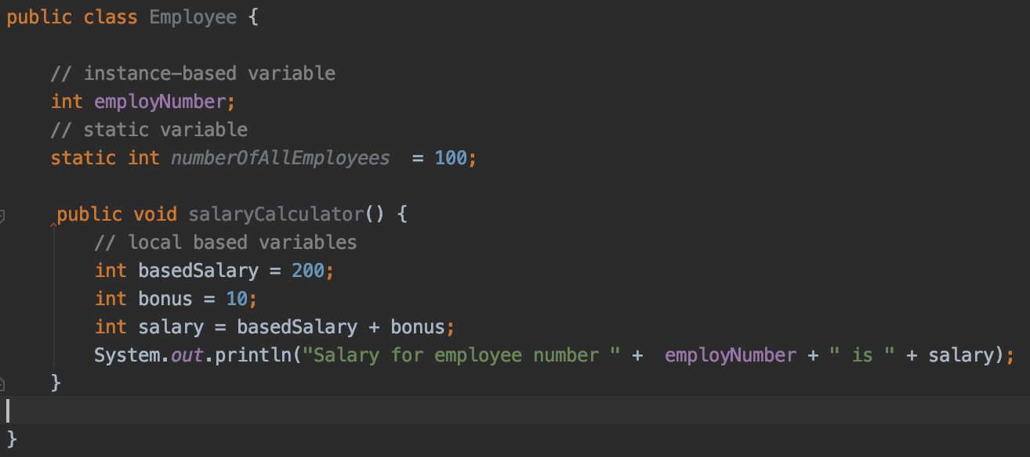
Variables
Q: Which of these 2 variables - employeeNumber, basedSalary - could be accessed from the main method ?

Slide 19
Demo
Java_module_2 -> jababasics_demos_2 -> variables -> Employee

Slide 20
Facts about the quiz
Kinds of Variables
Instance variables
Fields with no static in it with default values!
Class variables
Fields with static in it with default values
Local variables
Declared between open and close braces {} with NOT default state

Slide 21
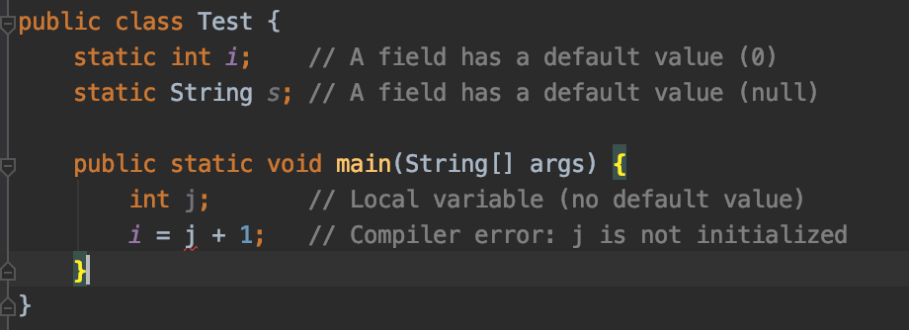
Facts about the quiz
Default values
Only class and instance variables has default values as 0, null or false

Slide 22
Facts about the quiz
Naming of variables
You must only need to be able to determine if a name is valid or not for the Java compiler
Valid names start with currency ($), underscore (_) or letter
Subsequent characters can also be digits
Letter is: a-z, A-Z (or the corresponding Unicode codes)
Digit is: 0-9 (or the corresponding Unicode codes)
E.g. all of next are valid variables
$
$123_
_abc123
\u0041___
_\u0041_

Slide 23
Facts about the quiz
It’s not allowed to use any Java reserved word or literal (null, true, false) as a variable name
Java variables are case-sensitive. Be careful about similar names that are really different variables!
Class
Only one public modifier is allowed per .java class for defining a class
The order of defining of a class is (always package is at top level) package <path_of_package>
import <other_packages_and_classes>
<classmodifier> class <className>

Slide 24
Facts about the quiz
javac compiles the java file and you need to pass the .java class
java executes the compiles class and you are passing only the class name
javac Test.java
java Test
Any more ?

Slide 25
Exercises
Java_module_2 -> exercises

Slide 26
Questions?
Notes:
Do you have any questions?

Slide 27
Thank You For Your Time

